Slide 1
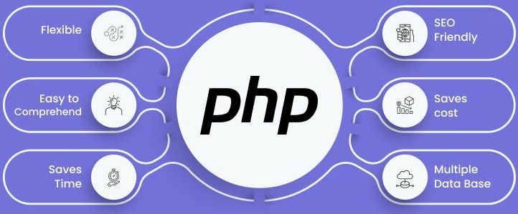

Slide 2
About today…
Date Time
Importance
Functions
Usage

Slide 3
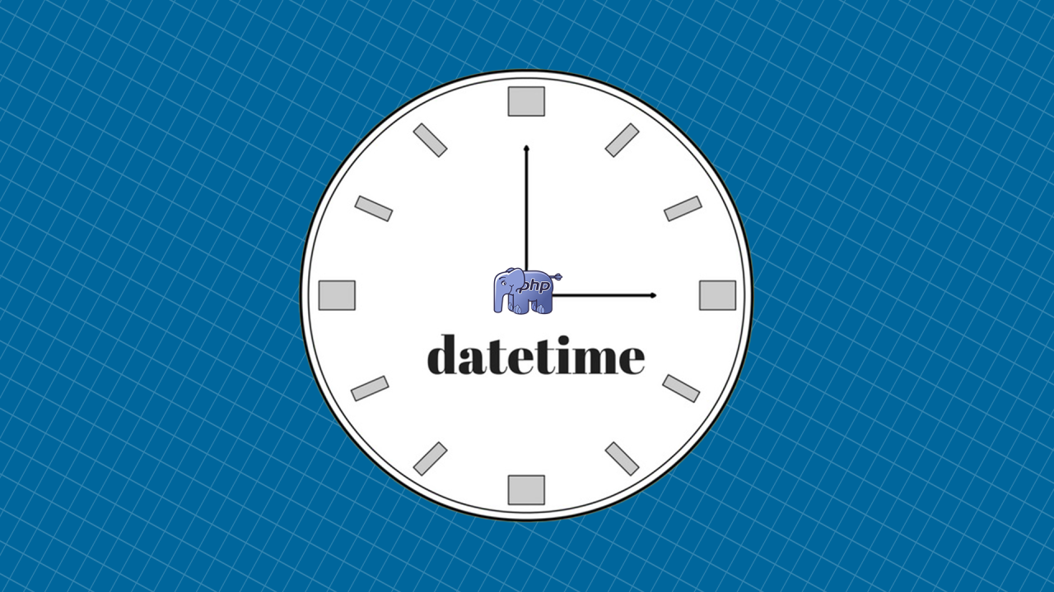
Working with
functions in PHP

Slide 4
Importance of Date and Time
Tracking Events
Keeping a record of when something happened (e.g., user sign-ups, logins)
Scheduling Tasks
Automating tasks at specific times (e.g., sending emails, running backups)
Logging Timestamps
Recording when actions occur for debugging and audit trails
User-Friendly Output
Displaying readable dates and times to users

Slide 5
PHP Date and Time Functions Overview
Common Functions
date()
Formats a local date and time
time()
Returns the current Unix timestamp
mktime()
Returns the Unix timestamp for a date
strtotime()
Parses an English textual datetime into a Unix timestamp
Classes
DateTime
A class for representing dates and times
DateTimeZone
A class for representing time zones

Slide 6
Using date() Function
Syntax
date(format, timestamp)
Common Formats
Y
Year (e.g., 2024)
H
Hour (00-23)
m
Month (01-12)
i
Minutes (00-59)
d
Day (01-31)
s
Seconds (00-59)
Example
If the timestamp is not provided, date() uses the current date and time

Slide 7

Getting the Current Timestamp
Using time() Function
Purpose
Returns the current Unix timestamp, which is the number of seconds since January 1, 1970
Example
Using microtime() for More Precision
Purpose
Returns the current Unix timestamp with microseconds
Example
Unix timestamps are useful for calculations and comparisons involving time

Slide 8

Creating a Timestamp with mktime()
Syntax
mktime(hour, minute, second, month, day, year)
Purpose
Creates a Unix timestamp for a specific date and time
Example
Use mktime() when you need a timestamp for a date other than the current date

Slide 9
Converting Strings to Timestamps with strtotime()
Syntax
strtotime(time, now)
Purpose
Converts a string representation of a date and time into a Unix timestamp
Example
strtotime() is useful for parsing human-readable dates into timestamps for calculations

Slide 10


Working with DateTime Class
Creating a DateTime Object
Setting a Specific Date
The DateTime class provides more flexibility and methods for manipulating dates and times compared to procedural functions

Slide 11

Modifying Dates with DateTime Class
Adding and Subtracting Time
The modify() method allows you to easily adjust dates by adding or subtracting time intervals

Slide 12


Working with Timezones
Setting a Timezone
Changing Timezones
Timezones are important for applications that need to support users from different regions

Slide 13


Slide 14

What function in PHP is used to get the current Unix timestamp?
time()
How do you format the current date and time in PHP to display as "Year-Month-Day Hour:Minute"?
echo date("Y-m-d H:i:s");
What does the strtotime() function do?
It converts a string representation of a date and time into a Unix timestamp
Which PHP class would you use to work with dates and times in a more flexible way compared to procedural functions?
DateTime
Which function would you use to convert a timestamp back to a formatted date string?
date()

Slide 15

Task 1
Write a PHP script to display the current date and time in the format Y-m-d H:i:s
Task 2
Write a PHP script that calculates and displays the age of a person based on their birthdate
Task 3
Write a PHP script that displays the date 10 days from today

